Slide 1
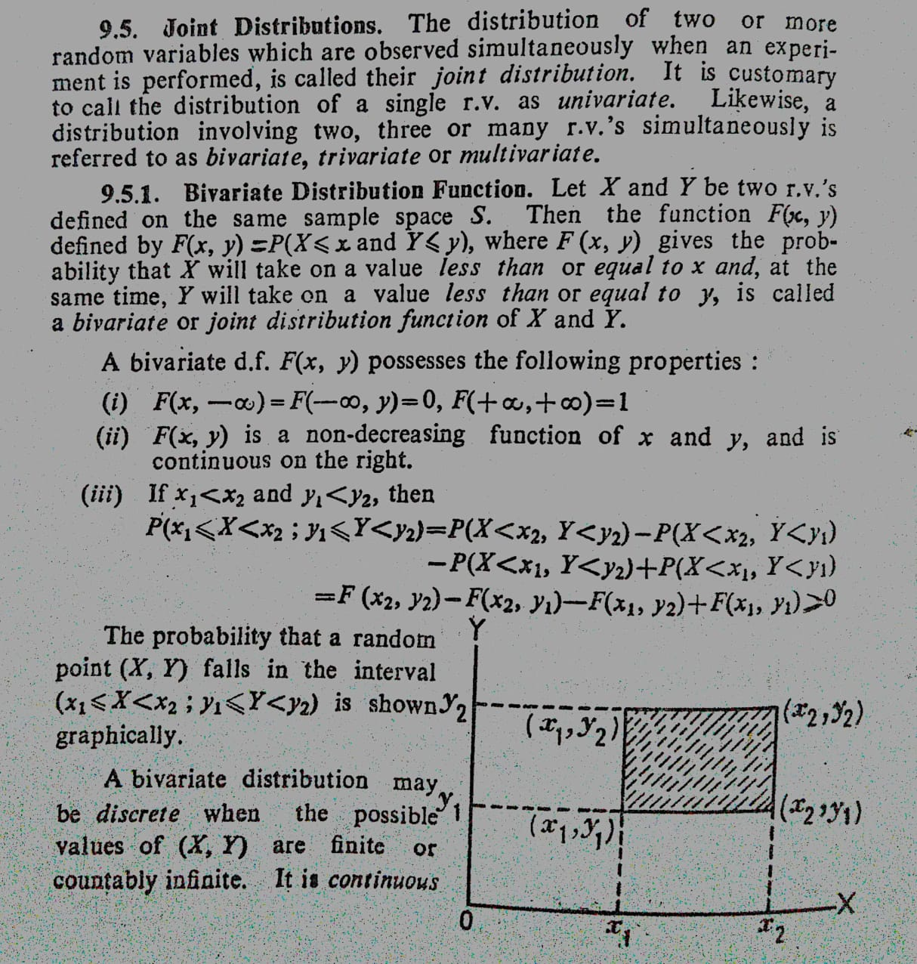
Joint Probability Distribution

Slide 2
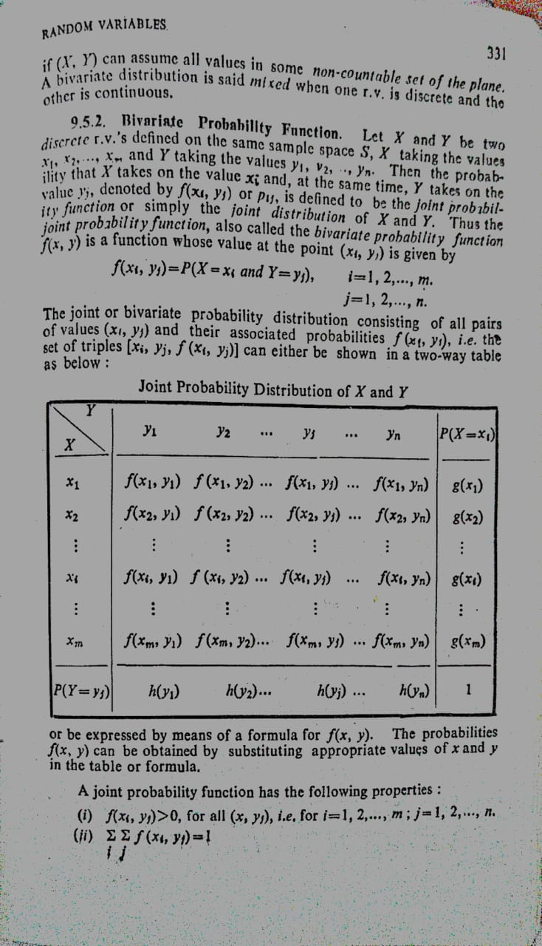
Joint Probability Distribution

Slide 3
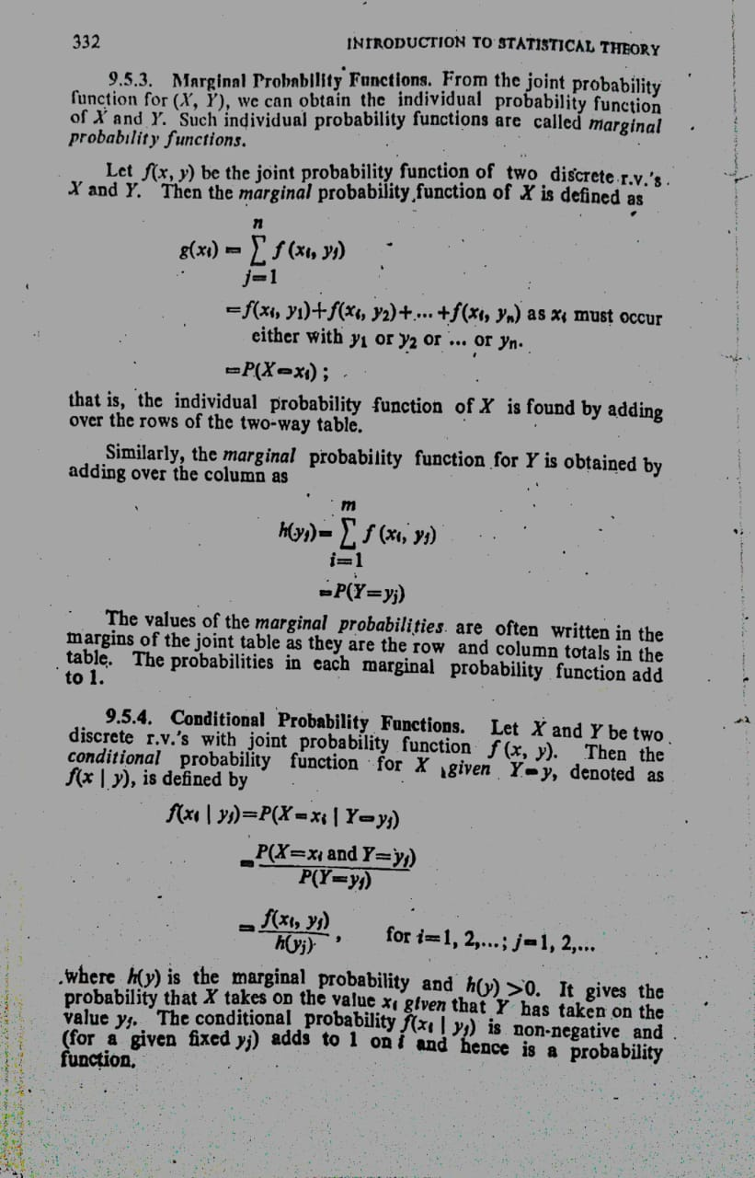
Joint Probability Distribution

Slide 4
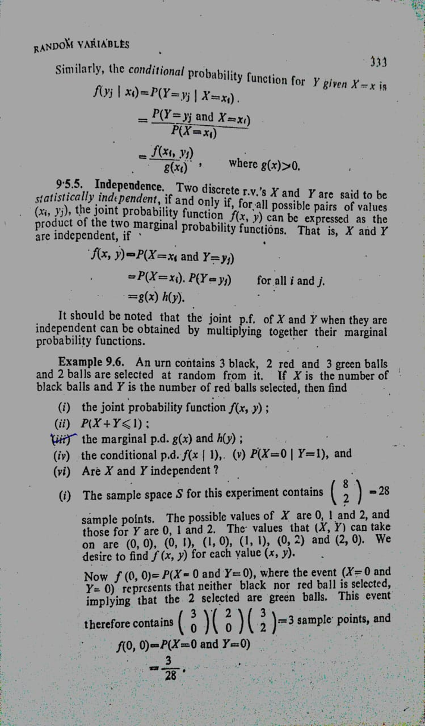
Joint Probability Distribution

Slide 5
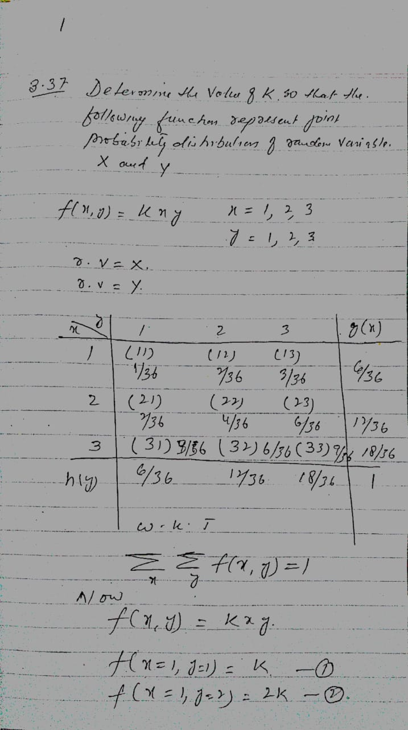
Joint Probability Distribution

Slide 6
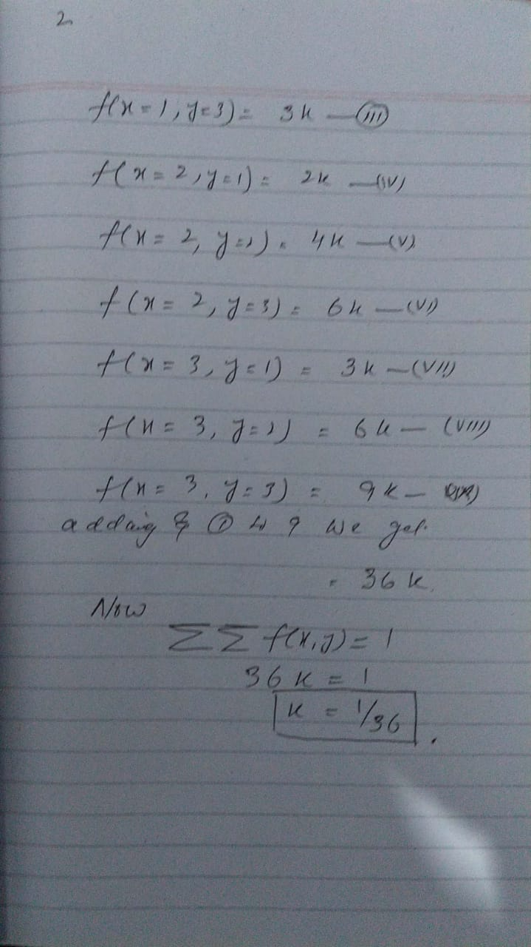
Joint Probability Distribution

Slide 7
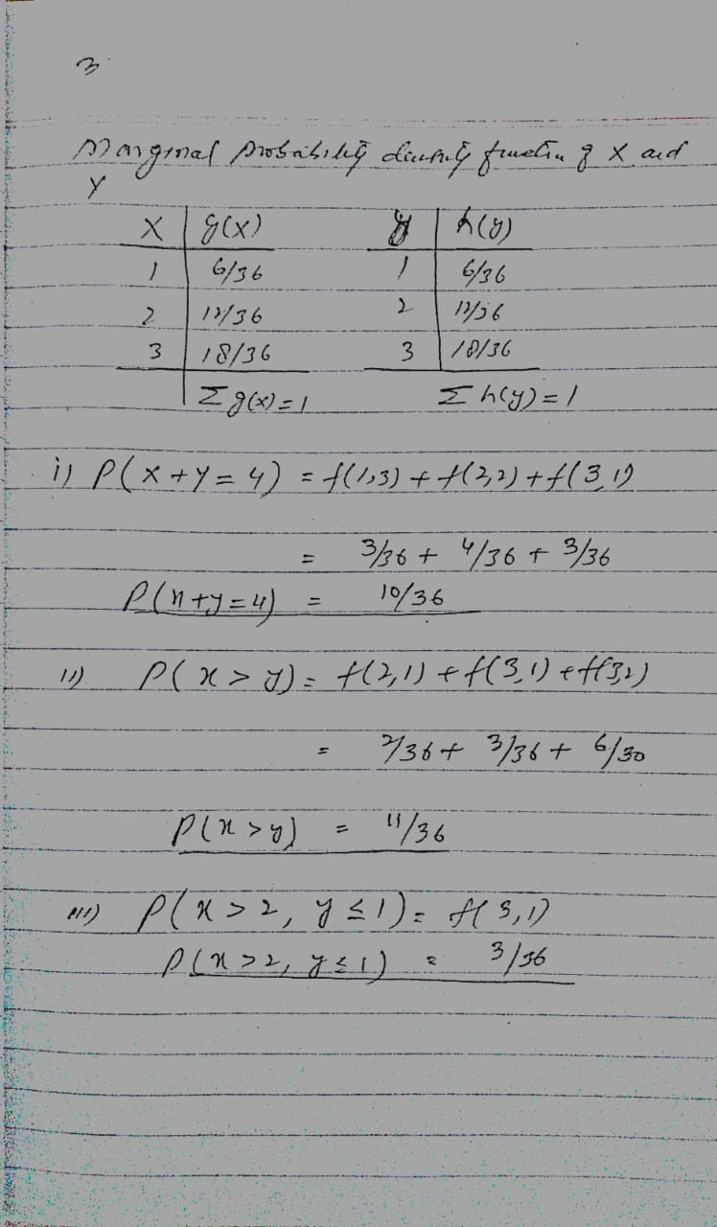
Joint Probability Distribution

Slide 8
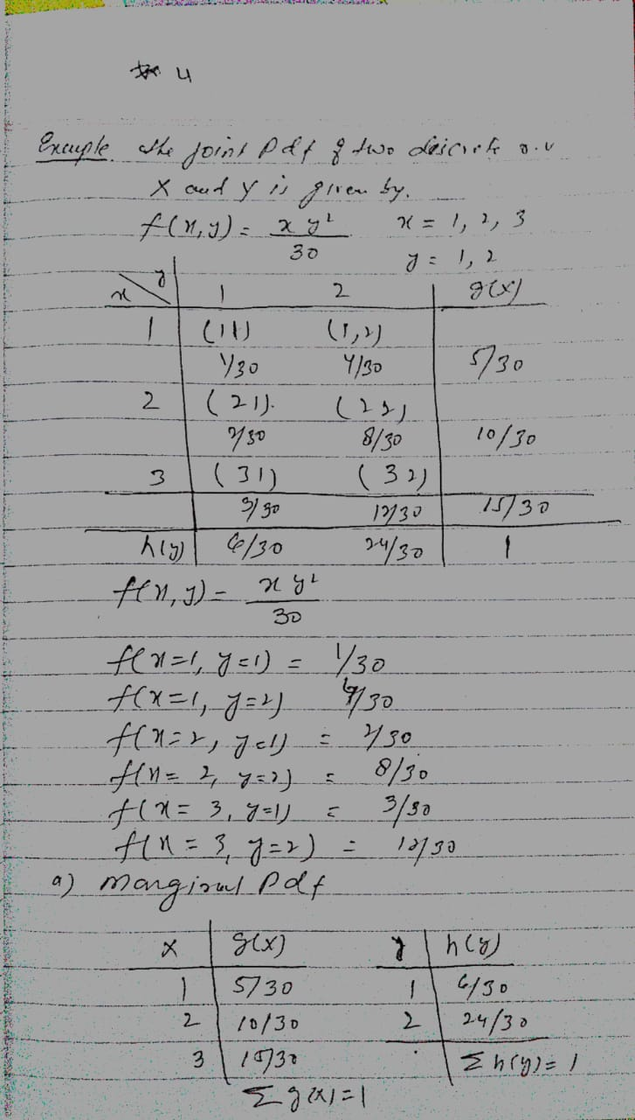
Joint Probability Distribution

Slide 9
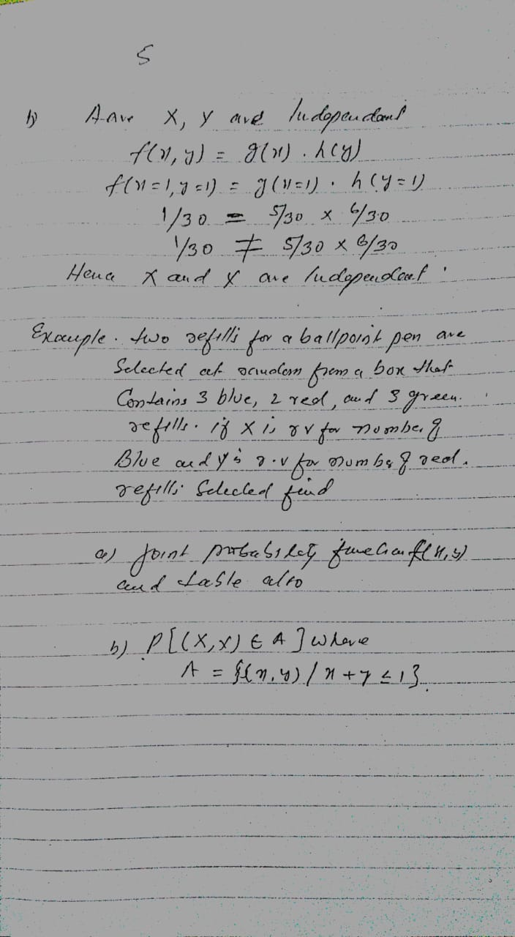
Joint Probability Distribution

Slide 10
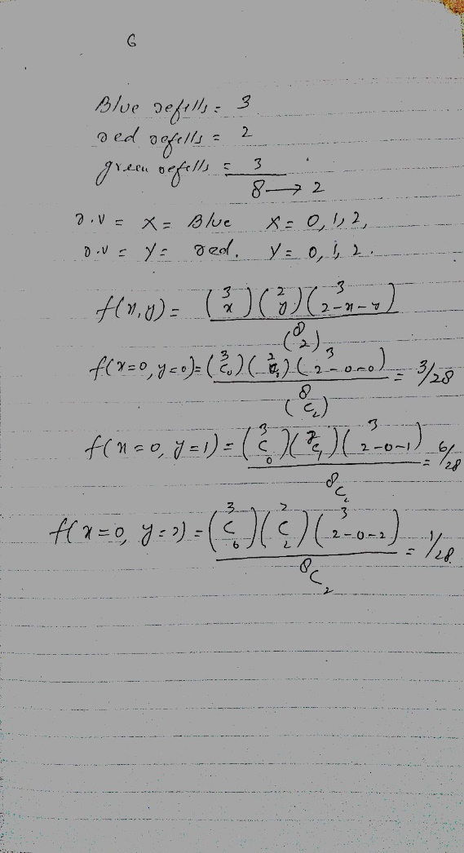
Joint Probability Distribution

Slide 11
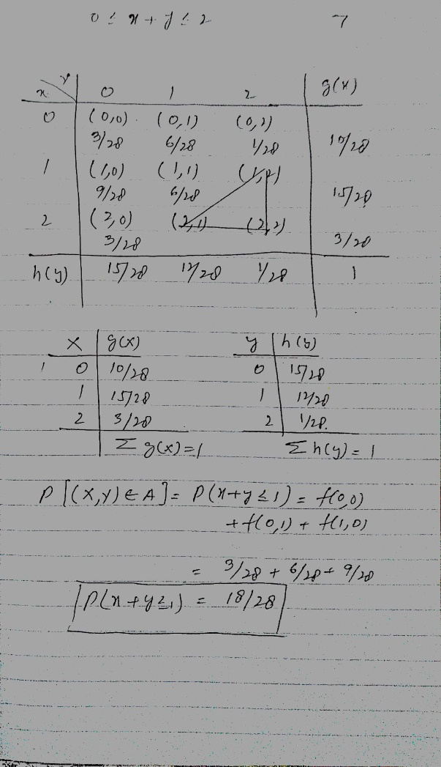
Joint Probability Distribution

Slide 12
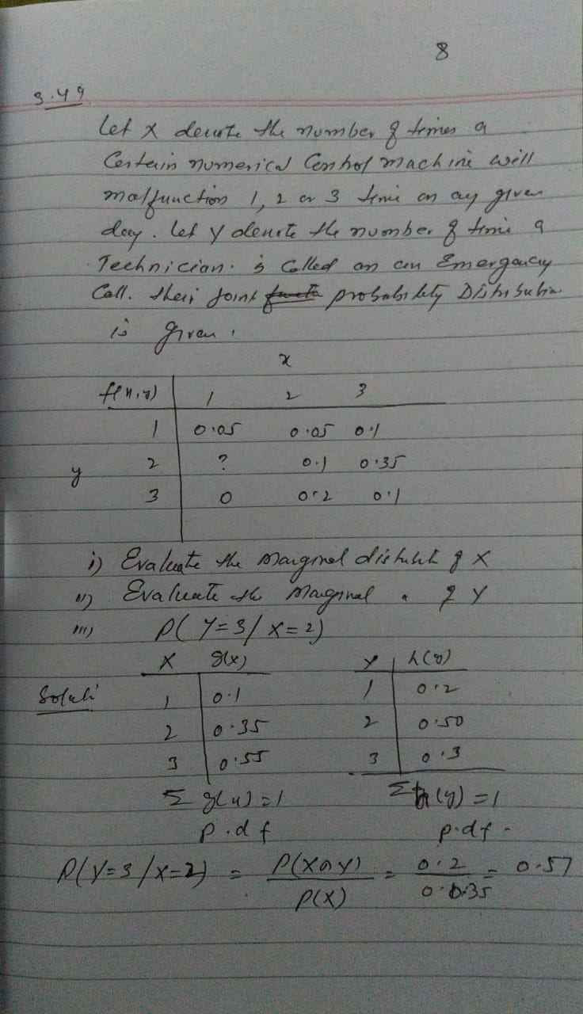
Joint Probability Distribution

Slide 13
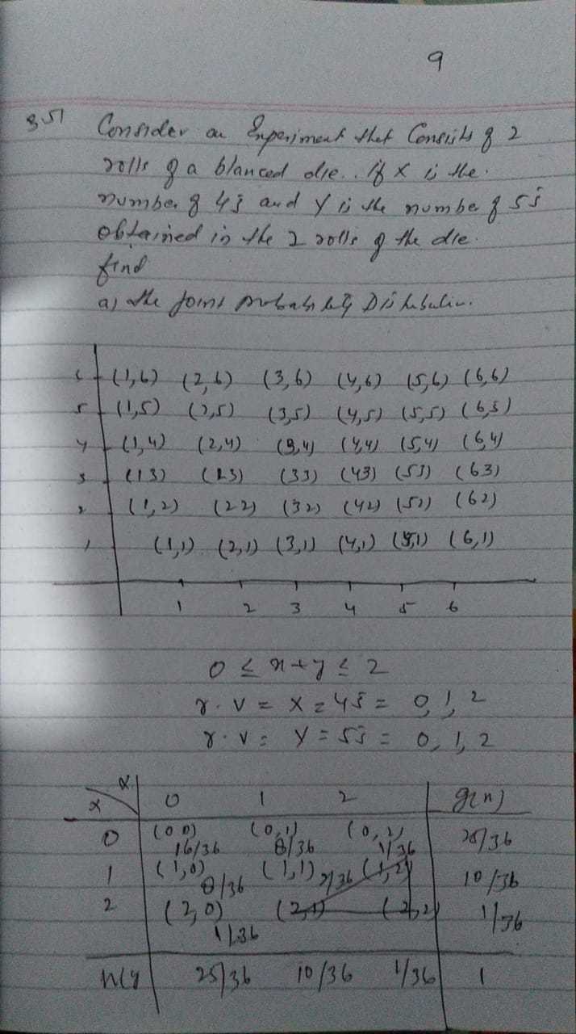
Joint Probability Distribution

Slide 14
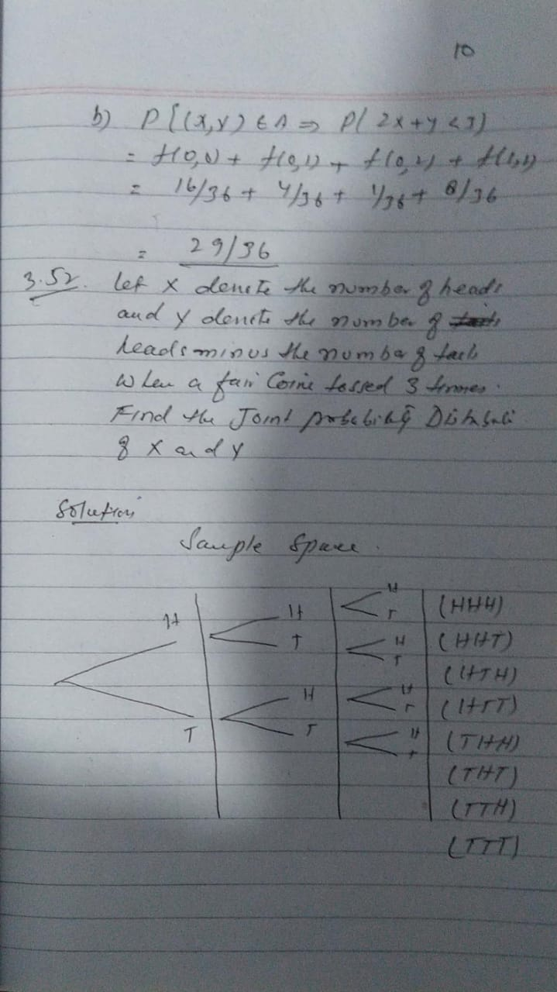
Joint Probability Distribution

Slide 15
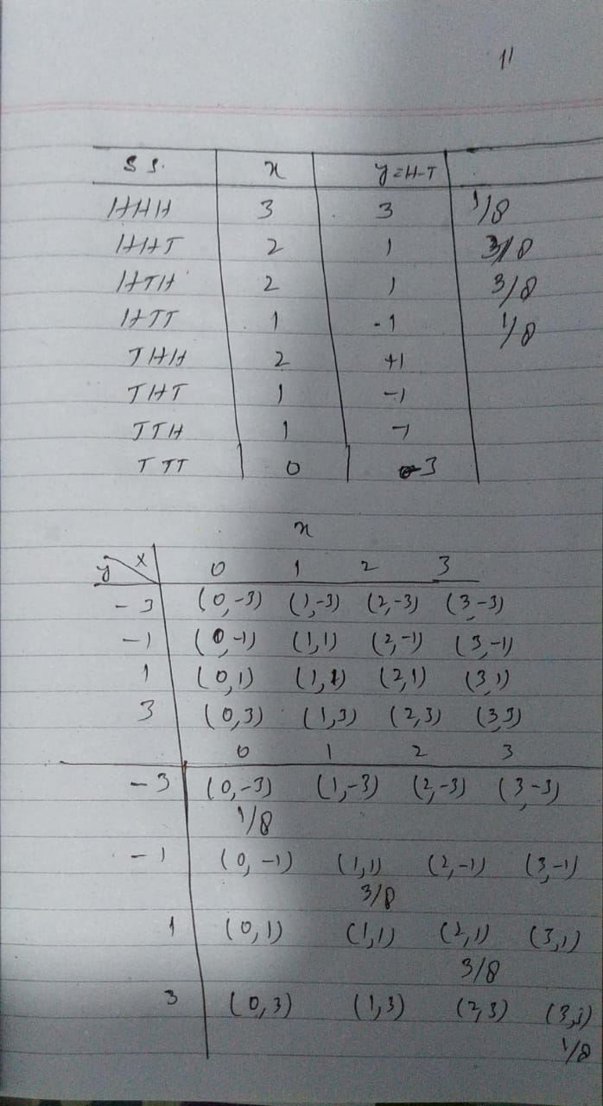
Joint Probability Distribution

Slide 16
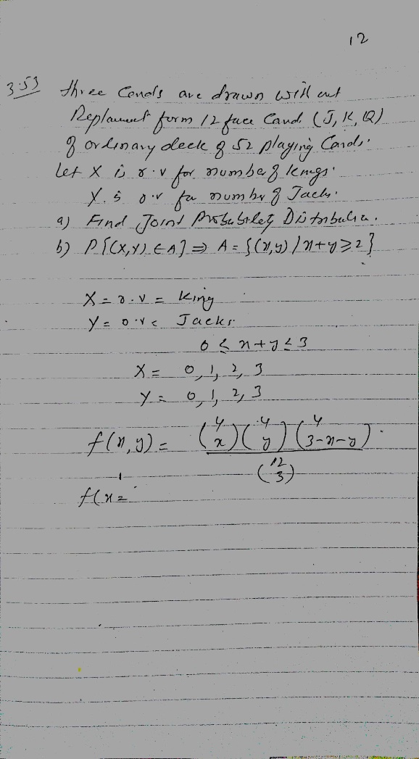
Joint Probability Distribution

Slide 17
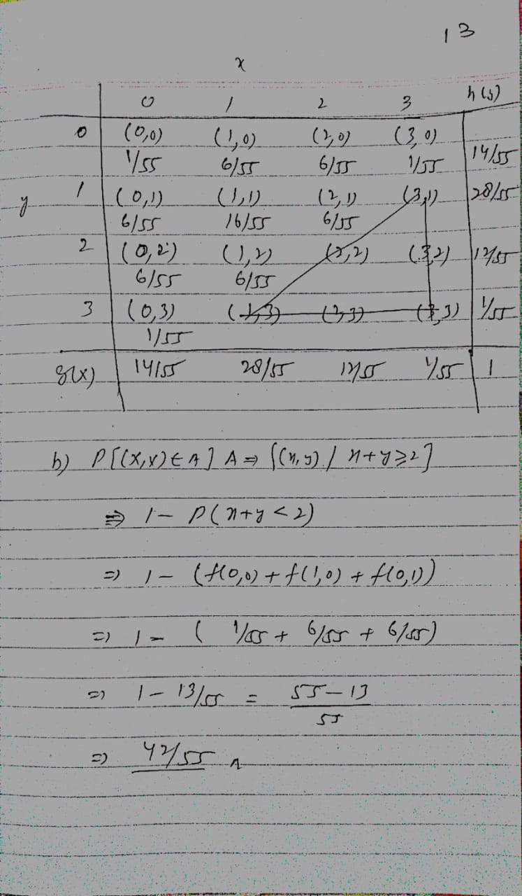
Joint Probability Distribution

